Slide 1
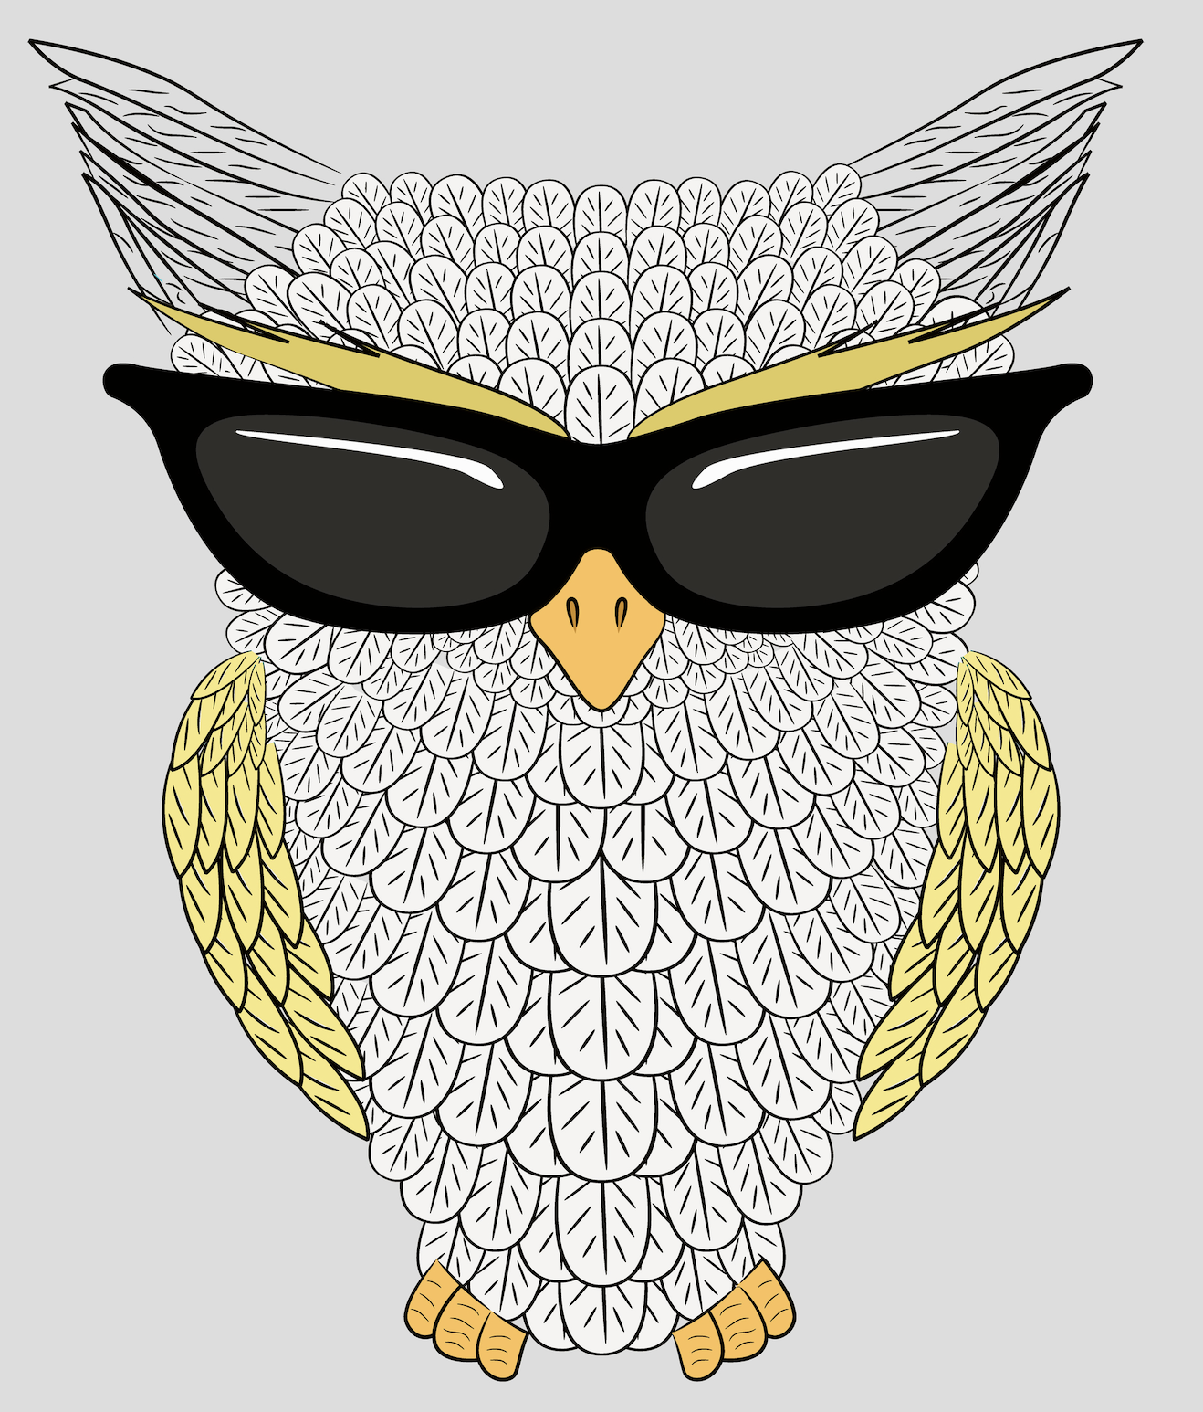
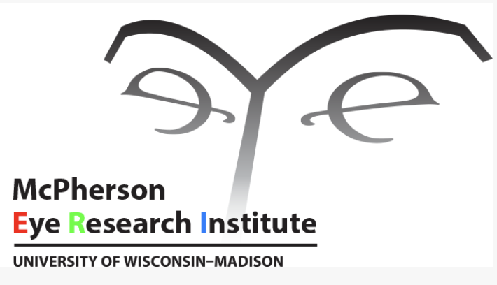
Be Wise & Shade Your Eyes
Doris Dubielzig & Anna Shen May 9, 2025

Slide 2
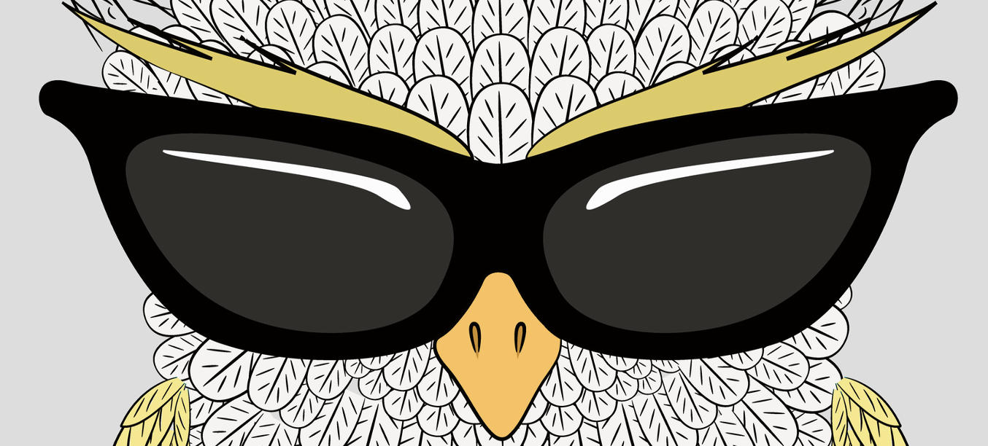
Be Wise & Shade Your Eyes
How do you protect yourself from the sun?
Why do you need to protect yourself from the sun?

Slide 3
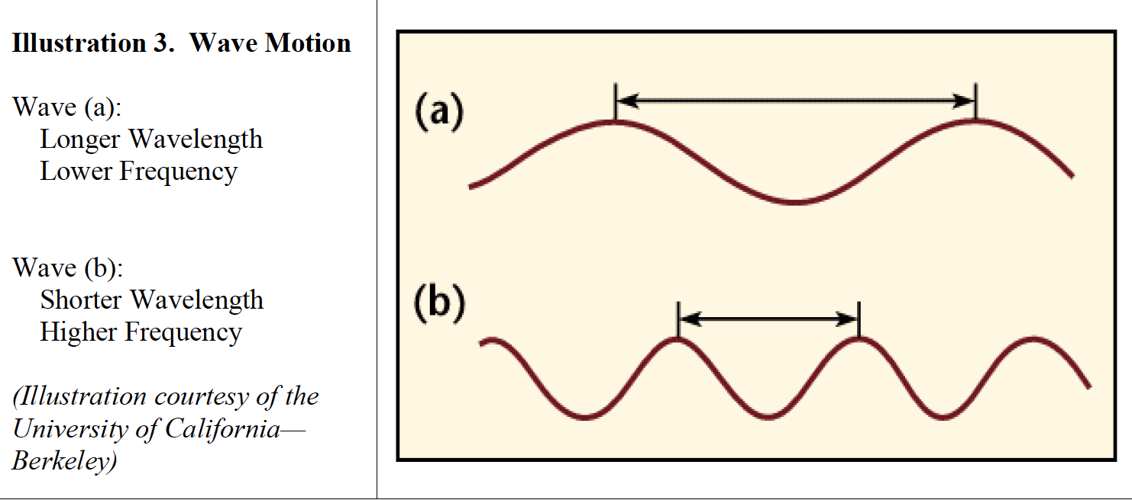
the colors of the rainbow & more
The Electromagnetic spectrum includes many types of radiation.
  It includes light radiation from a lamp and the sun
  Radio waves from a radio station
  The waves are ranked by wavelength and by their frequency.
What are the colors of the rainbow?
In addition to the colors we see in the visible spectrum, sunlight includes light waves we cannot see,
including infrared and ultraviolet.
Notes:
vibrations result in radiation. The electromagnetic (EM) spectrum is just a name that scientists give all of the different types of radiation when they want to talk about them as a group (see Illustration 2). Electromagnetic radiation is energy that spreads out as it travels. Visible light radiation that comes from a lamp in your house or radio wave radiation that comes from a radio station are two types of electromagnetic radiation. Other examples of EM radiation are microwaves, infrared and ultraviolet radiation, X-rays and gamma rays. Hotter, more energetic objects and events create higher energy radiation than cool objects. Only extremely hot objects or particles moving at very high speeds can create high-energy radiation like X-rays and gamma rays.
Illustration 2. (Illustration courtesy of Electro-optical Industries)

Slide 4
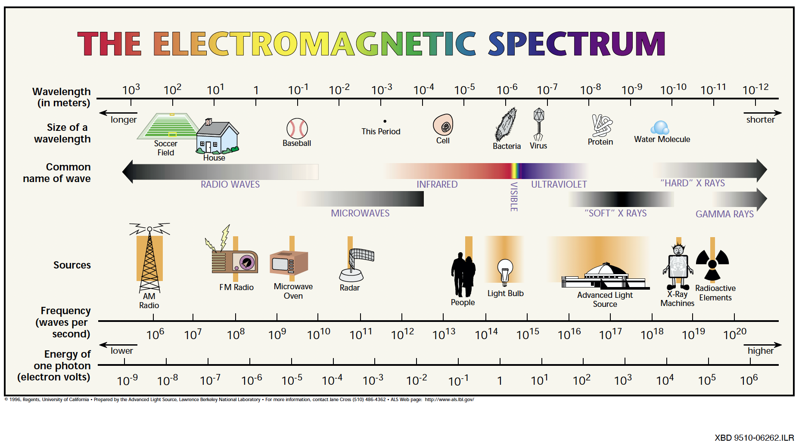

Slide 5
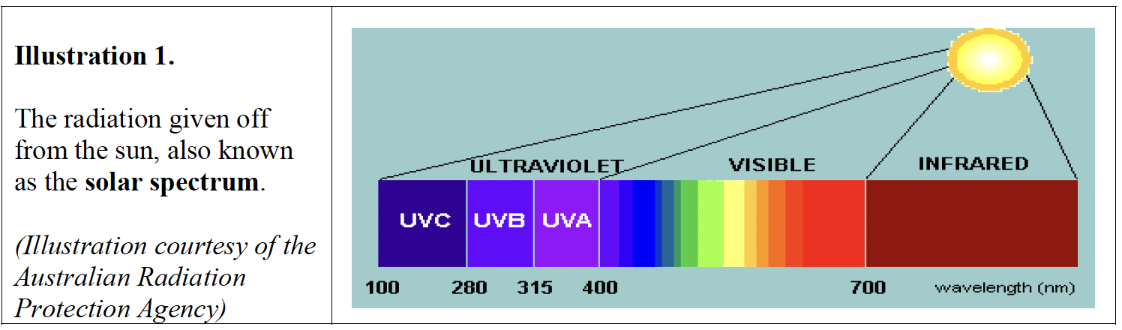
Ultraviolet light – 3 parts
The UV region covers the wavelengths ranging from 100–400 nm
is divided into
3 bands.UVA (315–400 nm)
UVB (280–315 nm)
As sunlight passes through
the atmosphere,
all UVC and approximately 90% of UVB radiation are absorbed by ozone, water vapor, oxygen and carbon dioxide. UVA radiation is less affected by the atmosphere. Therefore, the UV radiation reaching the Earth’s surface is largely composed of UVA with a small UVB component.
© World Health Organization 2002, © WPS Community Foundation, Inc. 2011

Slide 6
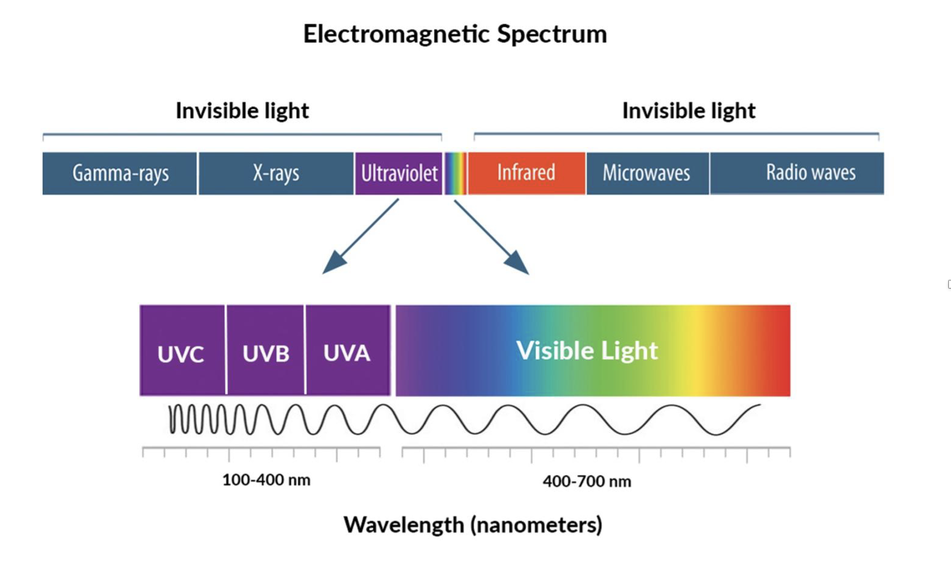
UVA is the longest and least energetic, 315 to 400 nanometers
UVB is 280 to 315 nanometers in length
UVC is the shortest and most energetic, 100 to 280 nanometers.
National Eye Institute (July 5, 2022)

Slide 7
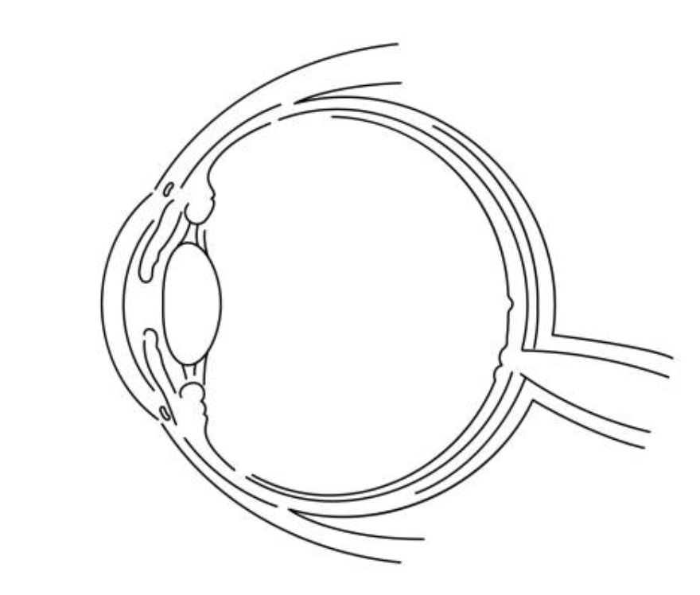
How Ultraviolet Light can damage the eye
UVA (least energetic) is absorbed by the cornea and lens,
but some can penetrate the eye all the way to the retina,
causing damage to the retina.
UVB damages DNA directly.
It’s responsible for sunburns and most UV-related cancers
and increases the risk of lens cataracts
UVC is most energetic, but it’s blocked by ozone and
only affects skin DNA.
Richard R. Dubielzig, DVM & Barbara Blodi, MD 2025; iStock image of the eye diagram

Slide 8
How the Sun Sees you
https://www.youtube.com/watch?v=o9BqrSAHbTc

Slide 9
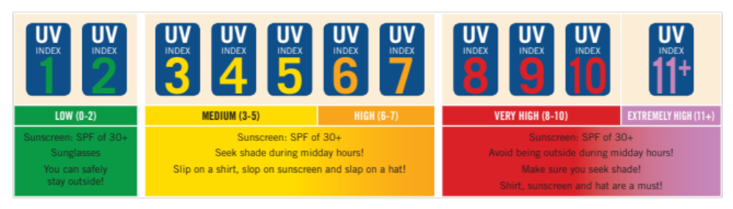
The UV index forecast for the day
https://www.epa.gov/sunsafety/uv-index-applications
This global index is used around the world!

Slide 10
Test lenses with UV-detecting Beads
String 3 UV-detecting beads onto 1 pipe cleaner.
Twist the end of the pipe cleaner so the beads don’t fall off.
Place the lens over the beads.
Turn on the UV flashlight (DO NOT SHINE THE LIGHT IN YOUR EYES).
Shine the UV light on the lens for 5 seconds.
Turn off the flashlight and check the beads. Did they change color?
The color of the beads is NOT related to the UV Index. (sorry)
The flashlights have a very narrow range of UVA: 395 – 405 nanometers

Slide 11
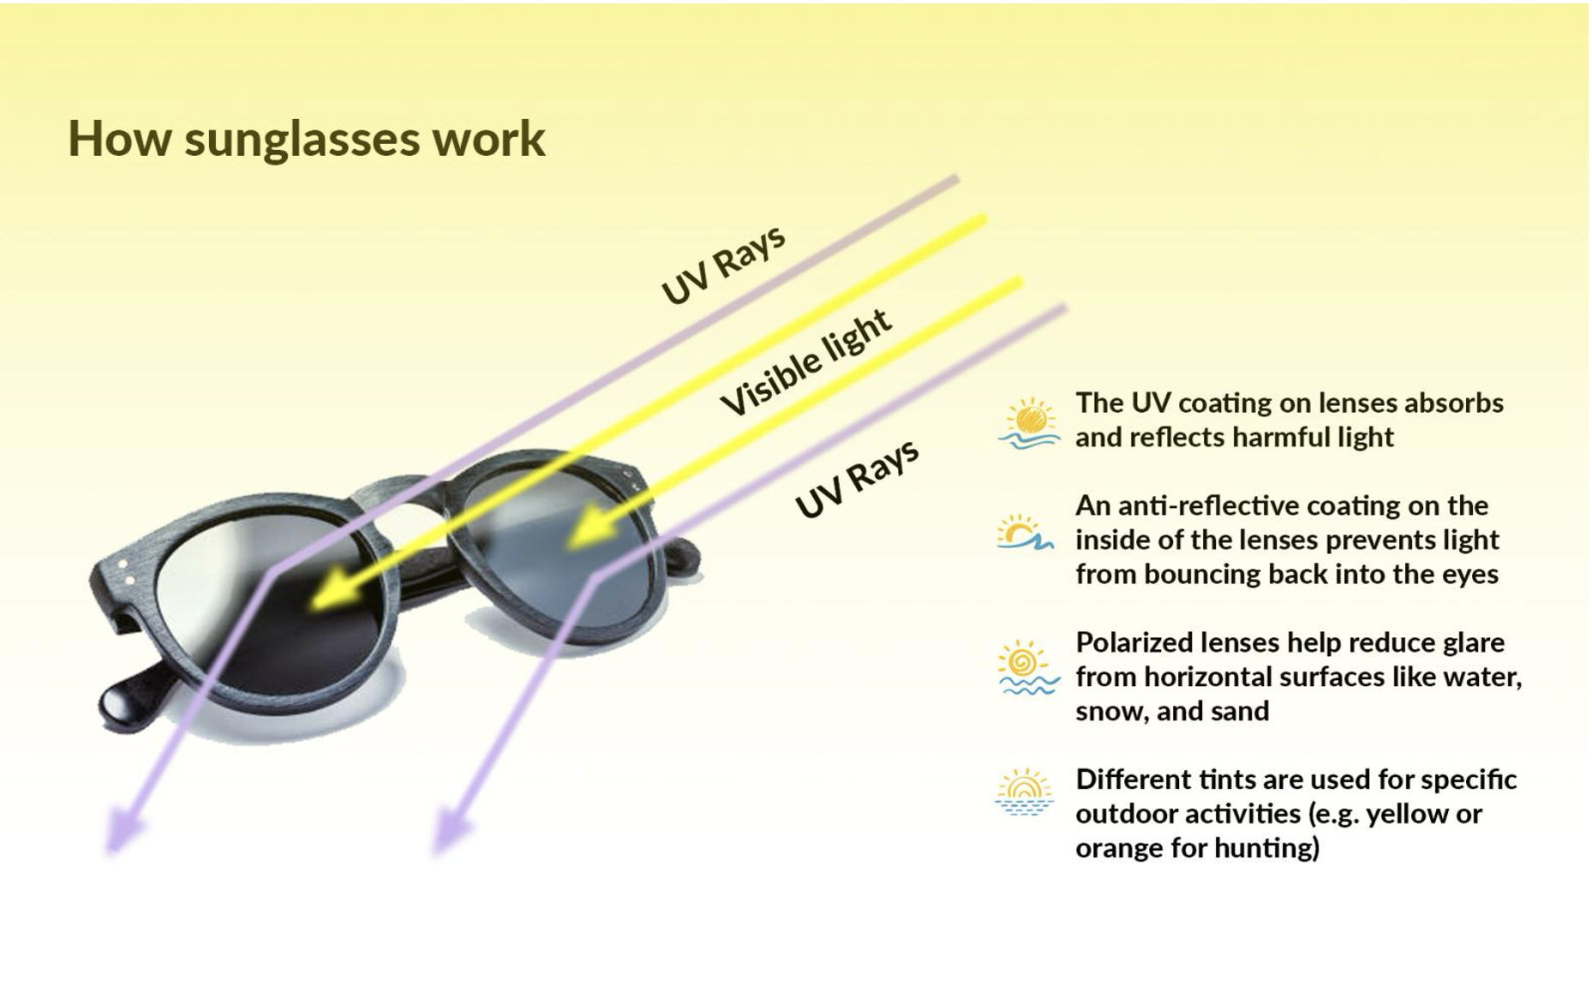
National Eye Institute (July 5, 2022)

Slide 12
Choosing sunglasses
Look for lenses that provide 99 to 100 percent protection from UVA and UVB or marked as having a UV400 rating
You don’t have to pay an arm and a leg for good sunglasses
Fit. Choose comfort over style
Use. Choose sunglasses according to your activity. Activities near water, snow, sand, and other reflective surfaces increase UV exposure by reflecting light. Polarized lenses are good for reducing glare from snow or water.
Some contact lenses block UV. You also can wear sunglasses over them
National Eye Institute (July 5, 2022)
The U.S. Food & Drug Administration (FDA) regulates non-prescription sunglasses as medical devices.
It requires that manufacturers and retailers meet minimum requirements for UV protection, lens quality,
impact resistance, labeling, and more. Unsure if your sunglasses have UV-blocking lenses? Many optical shops
have a device called a photometer to test them.

Slide 13
In closing
Take the beads with you (backpack/wrist/belt loop)
Seven Sight-saving Steps – share them with your family
Try other experiments with these beads --- effects of sunscreen/water/altitude?
THANK YOU!

